Slide 1
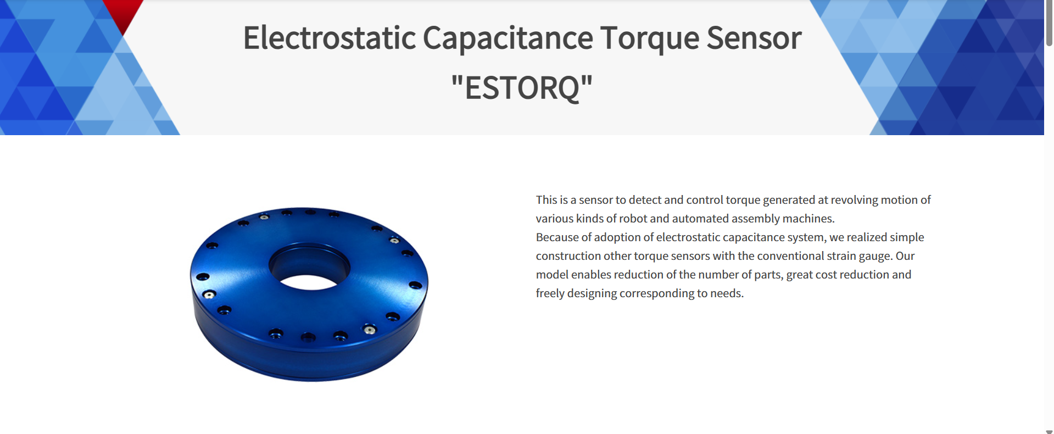
Capacitive Torque Sensor
Specifications
Measurable Torque – 100 Nm
Weight - 330g
Resolution - 10 bit
Operating Temp - 0-80° C
Reference Design

Slide 2
User Needs and Requirements
Light Weight
Accuracy and Precision
Structural Rigidity
Ease of Setup
Stability over time and Environmental Condition
Cost
Shareholders
Users ( Engineers)
Business Owners
Maintenance Technicians
Regulatory Bodies

Slide 3
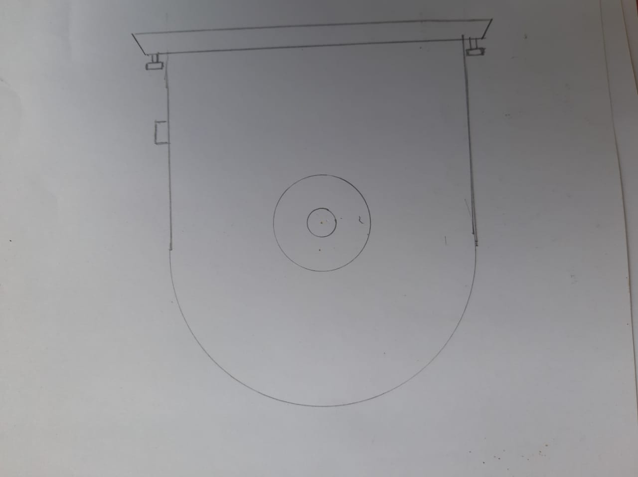
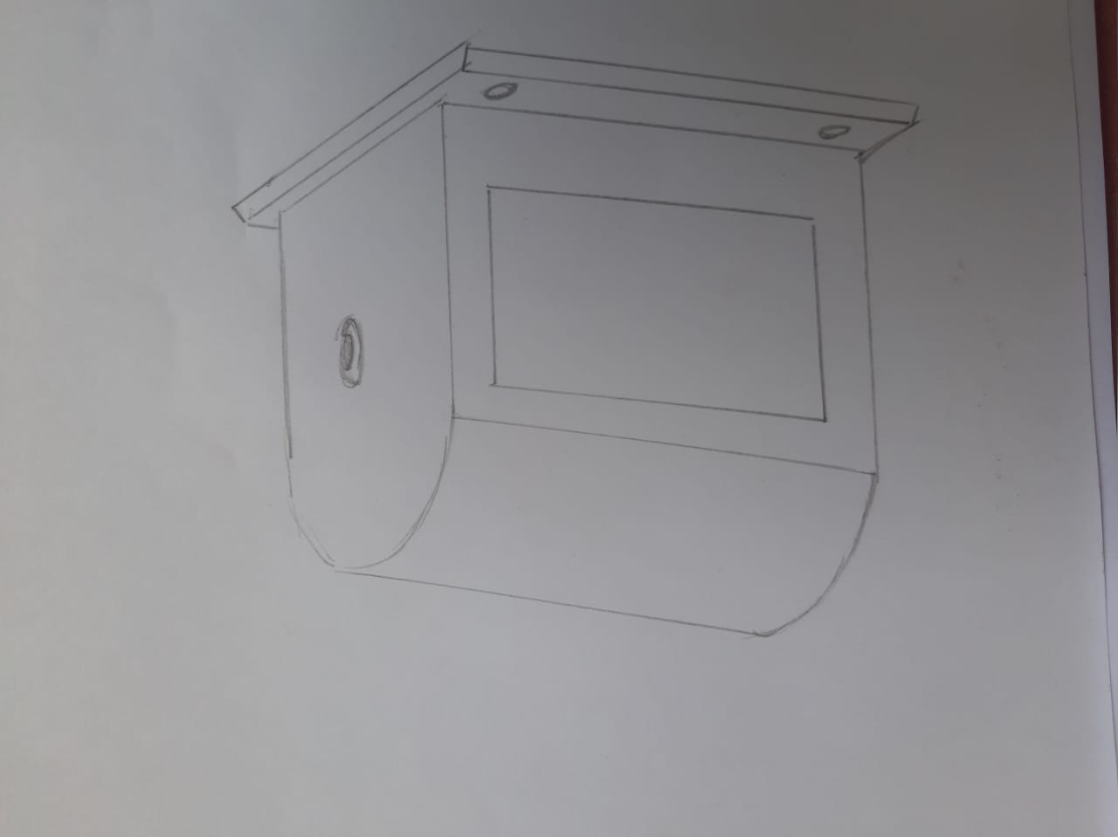
Conceptual Design
Front View
Isometric View

Slide 4
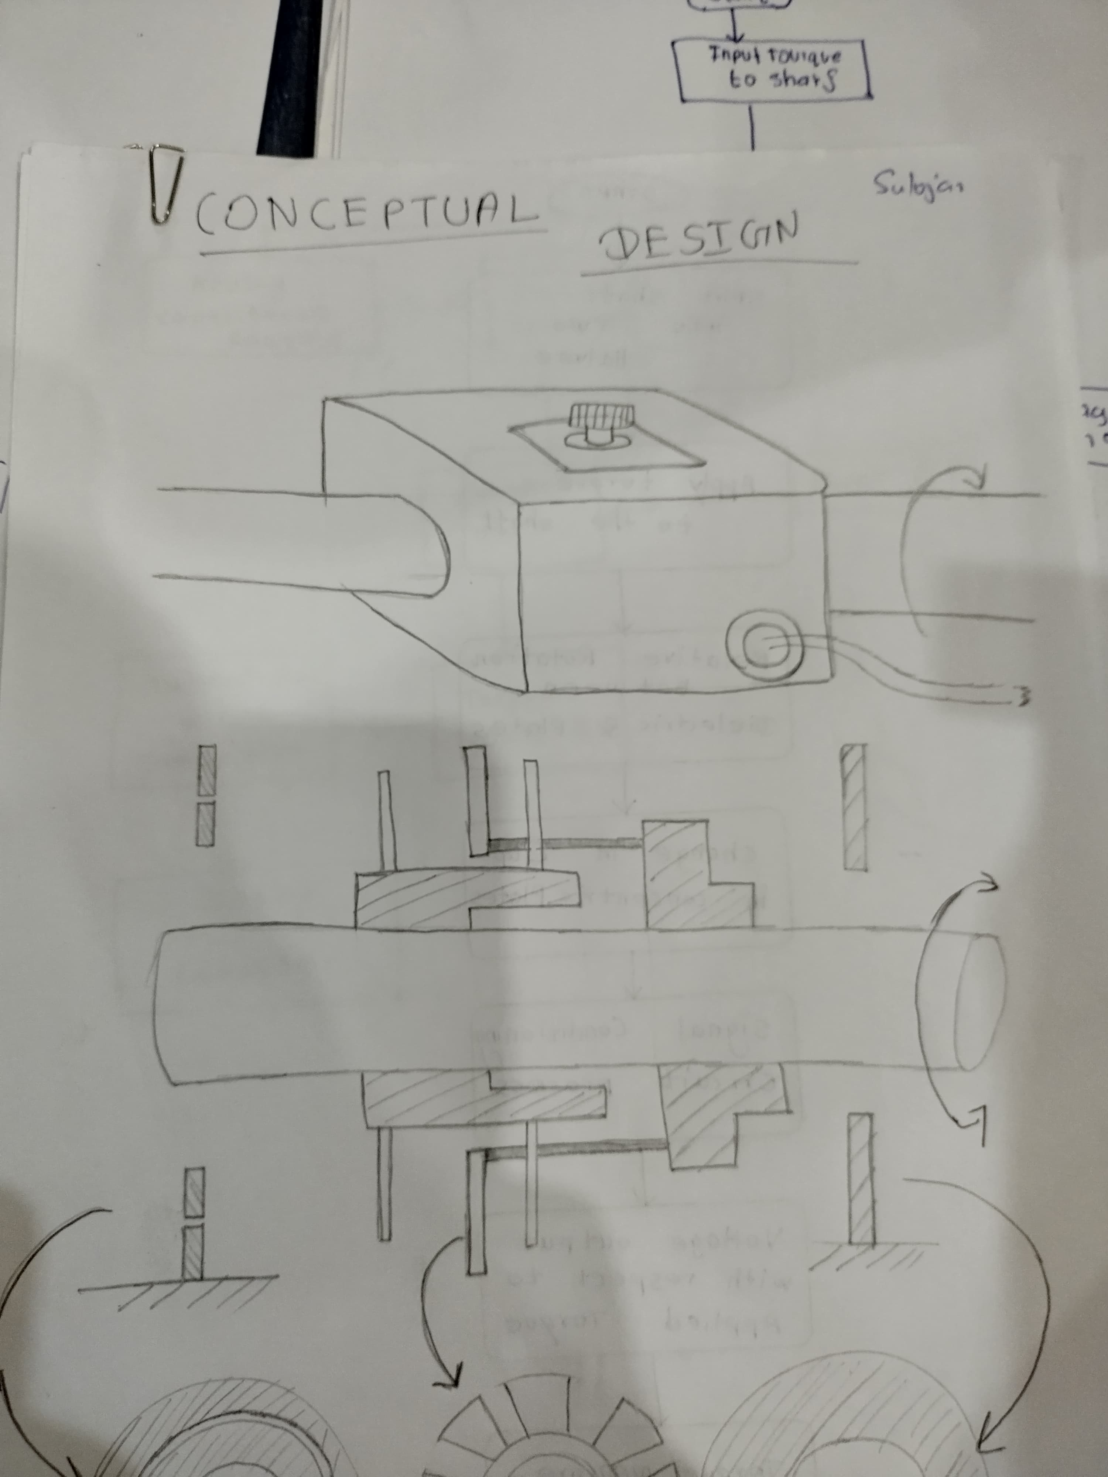
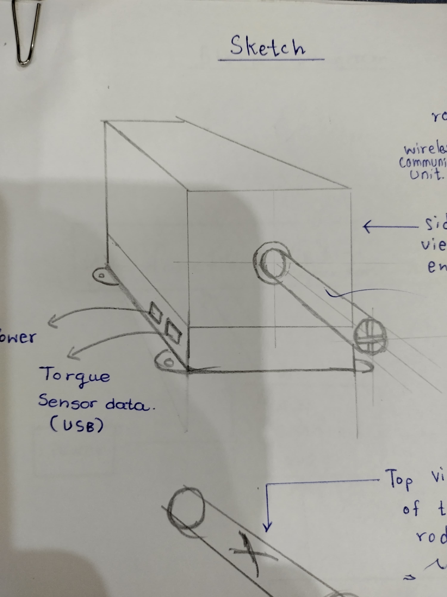
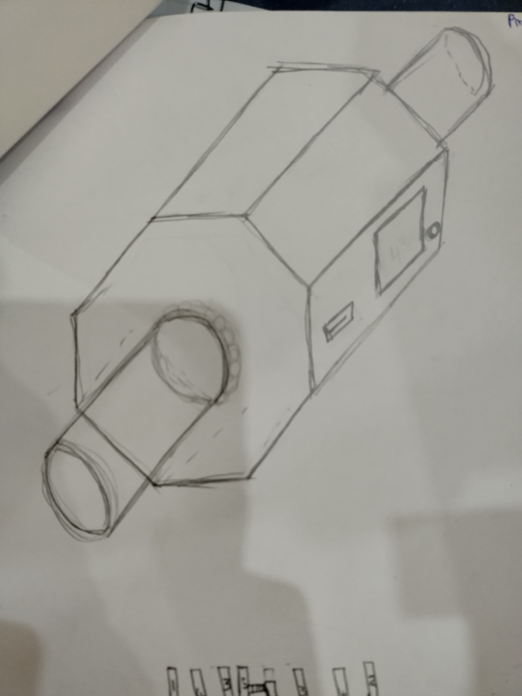
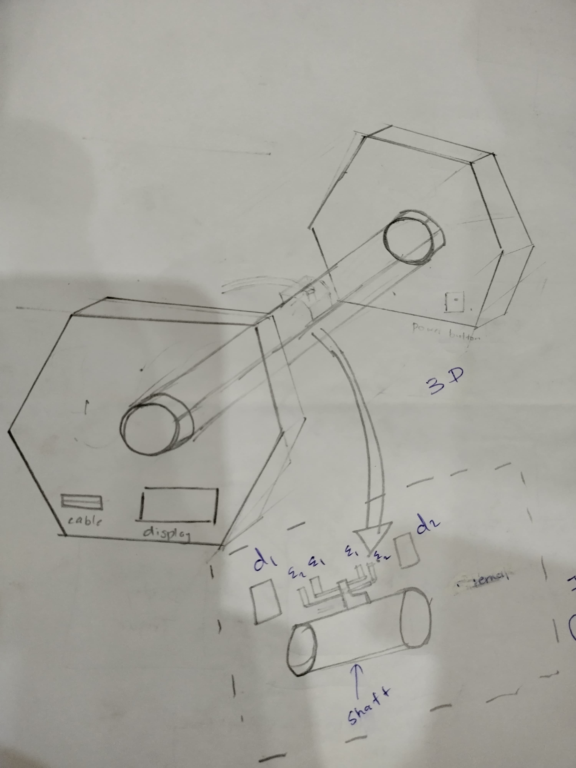
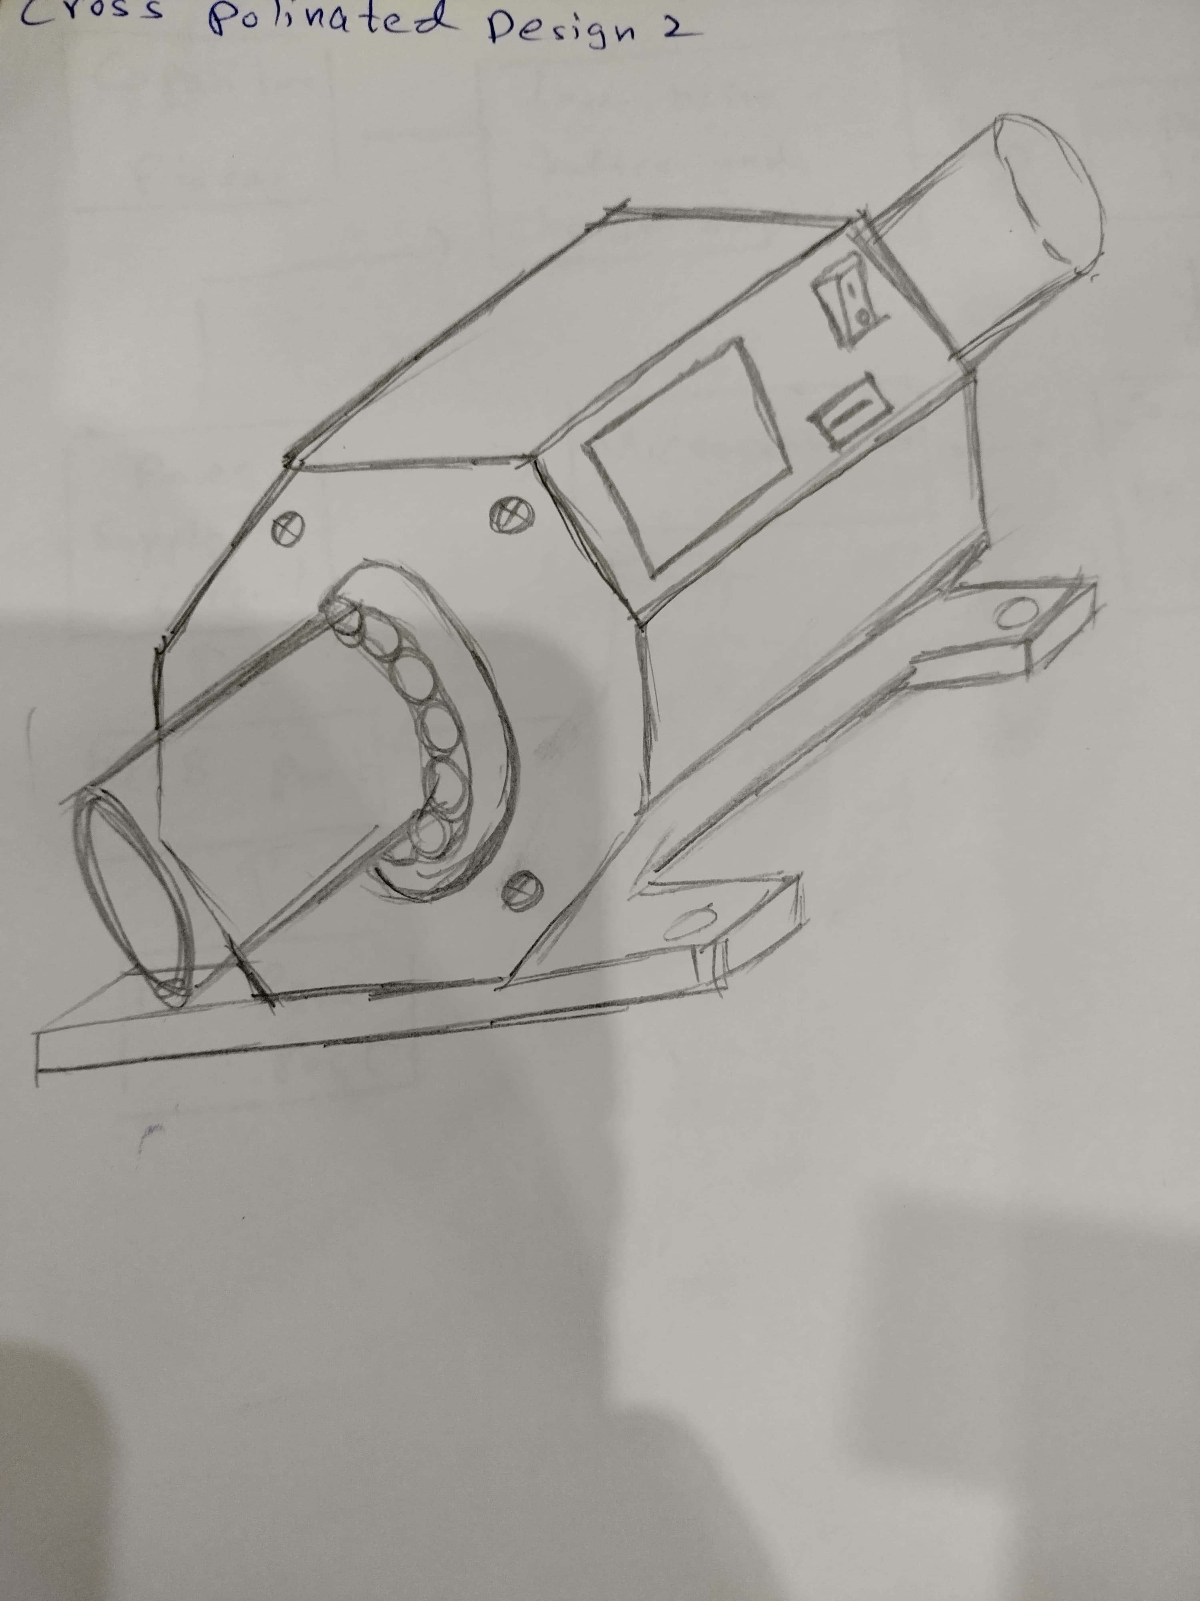
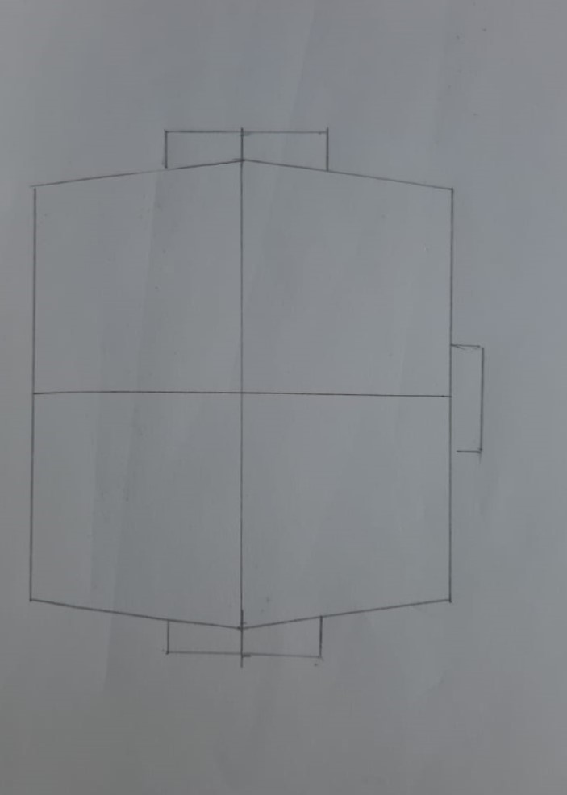
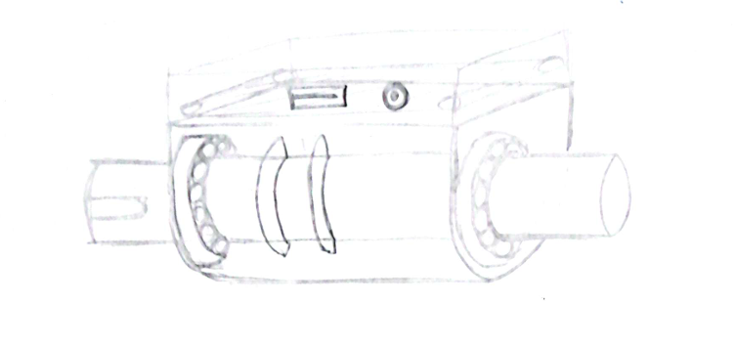
Individual Enclosure Designs

Slide 5
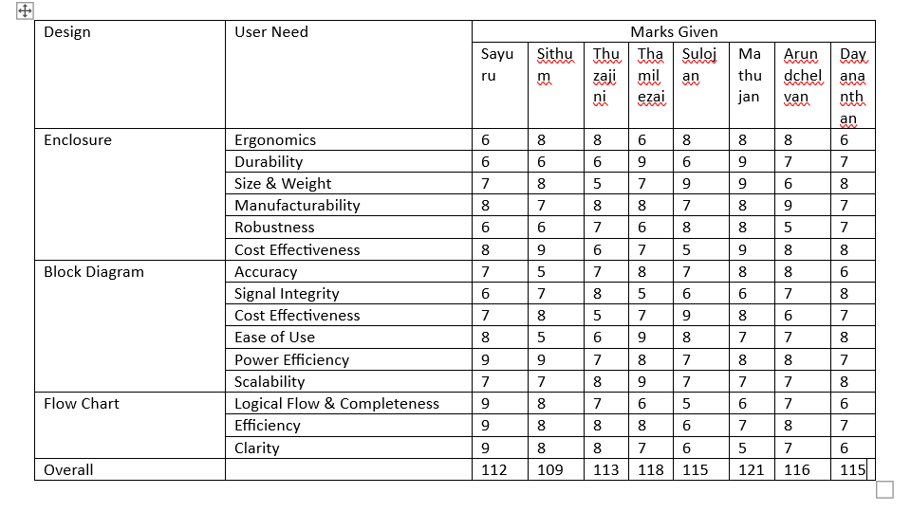
Conceptual Design Evaluation

Slide 6
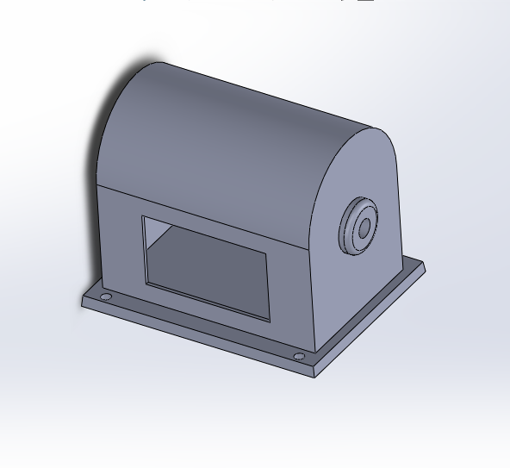
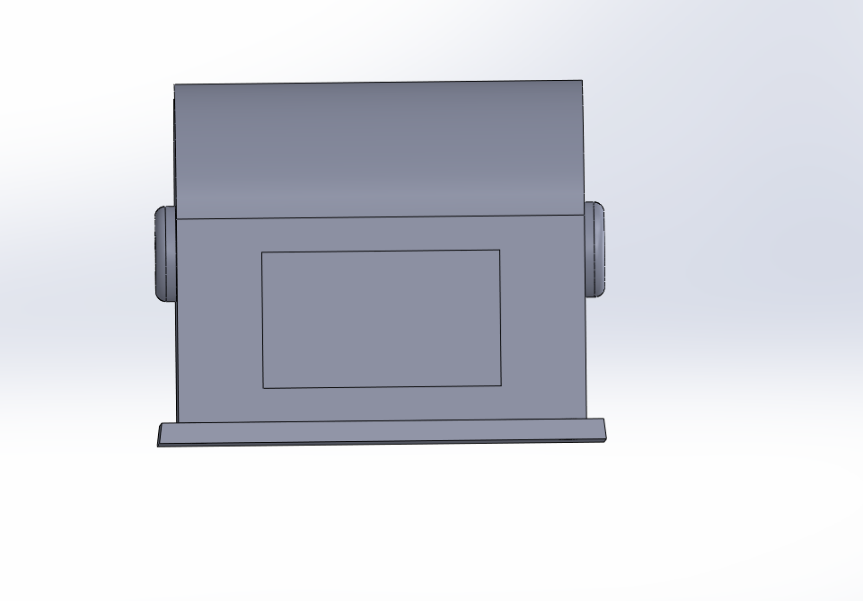

Enclosure Design
Isometric View
Side View
Front View

Slide 7
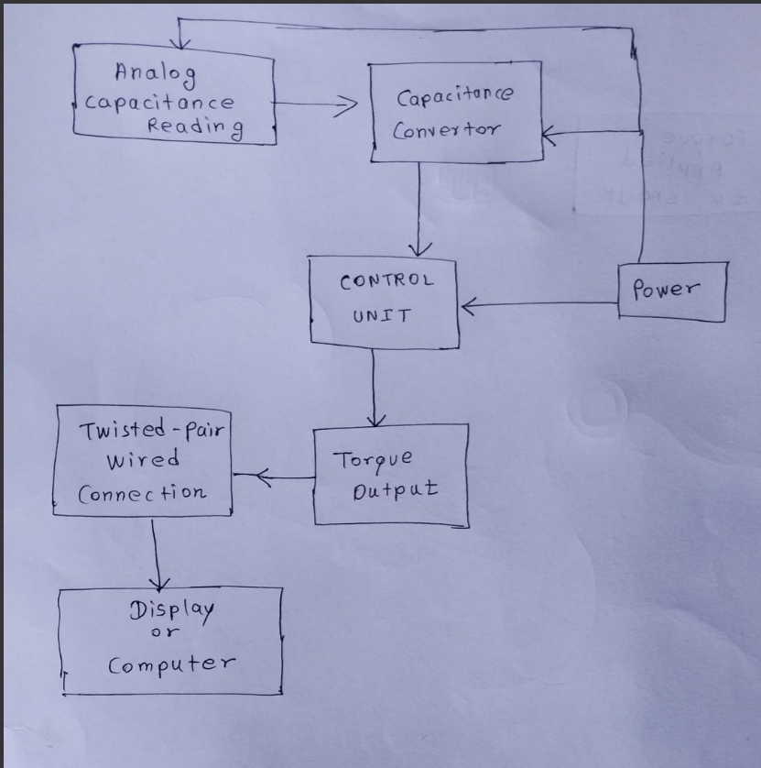
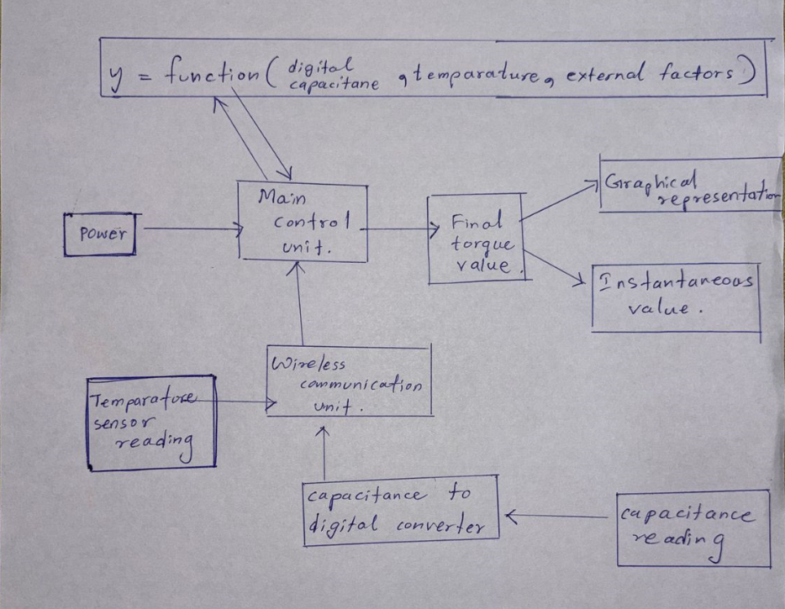
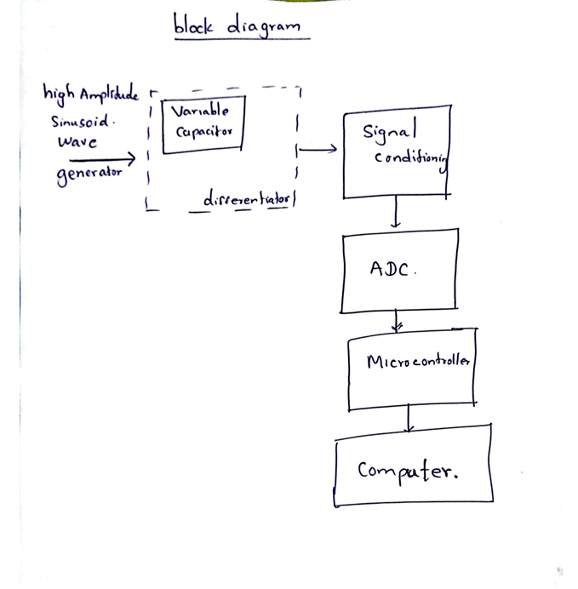
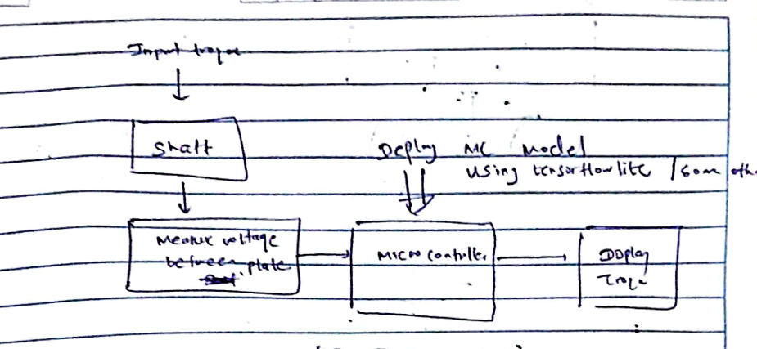
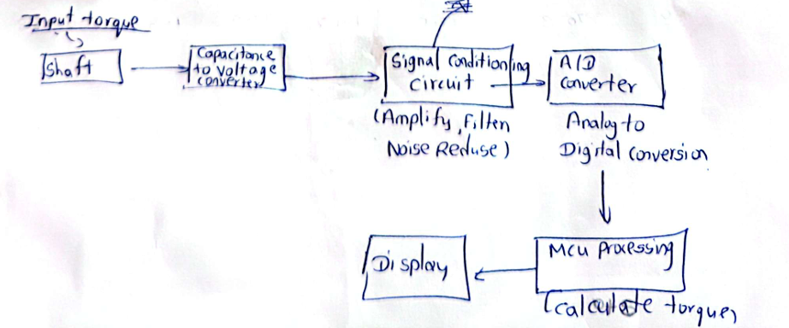
Individual Block Diagrams

Slide 8
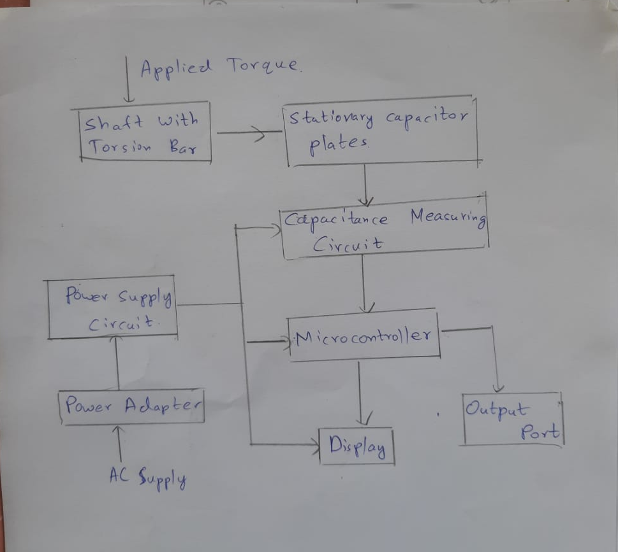
Final Block Diagram

Slide 9
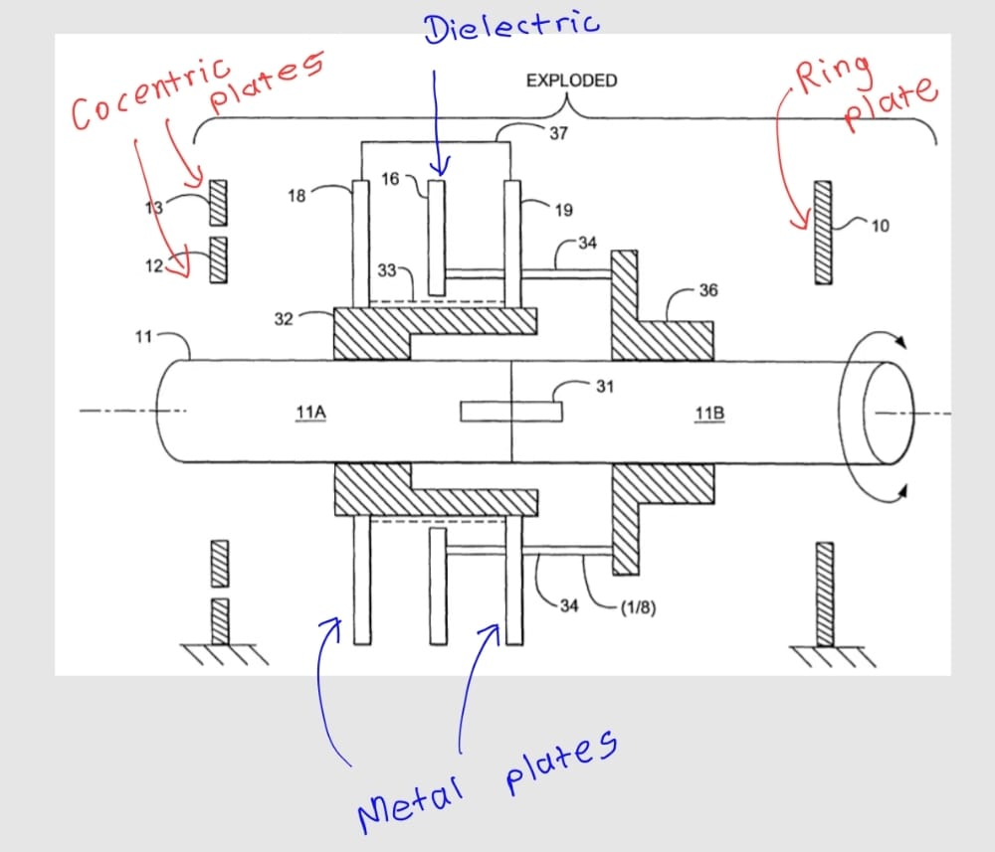
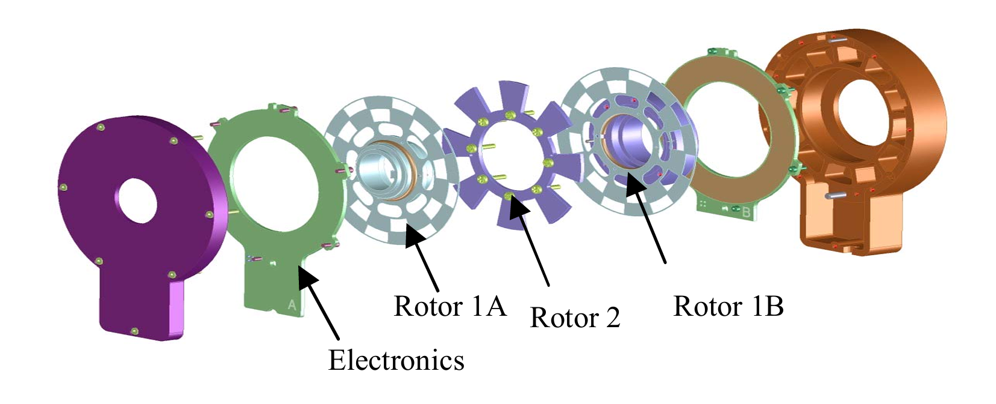
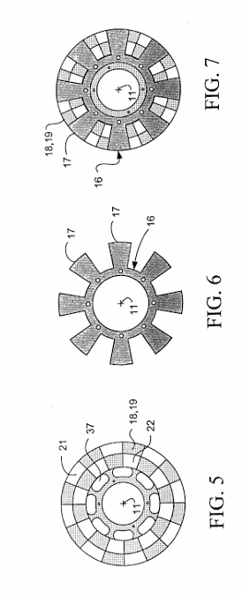
Internal Mechanism Concept
Internal Disks

Slide 10
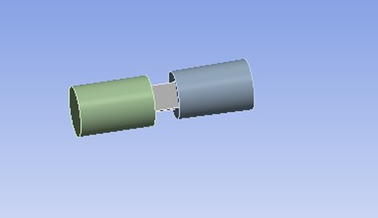
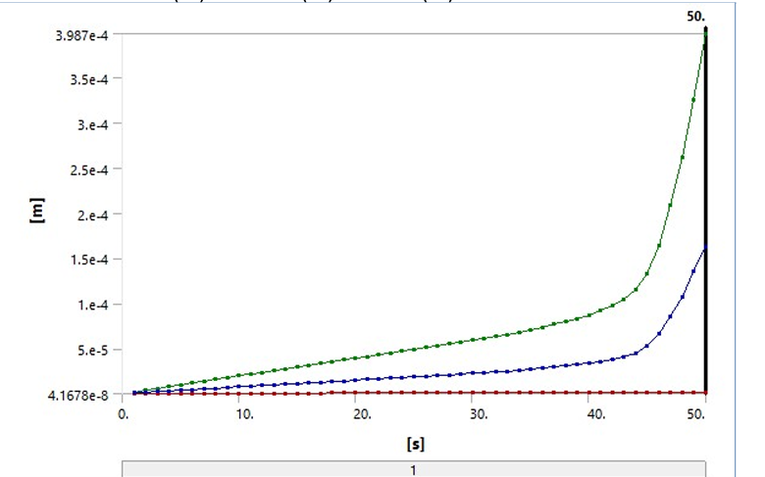
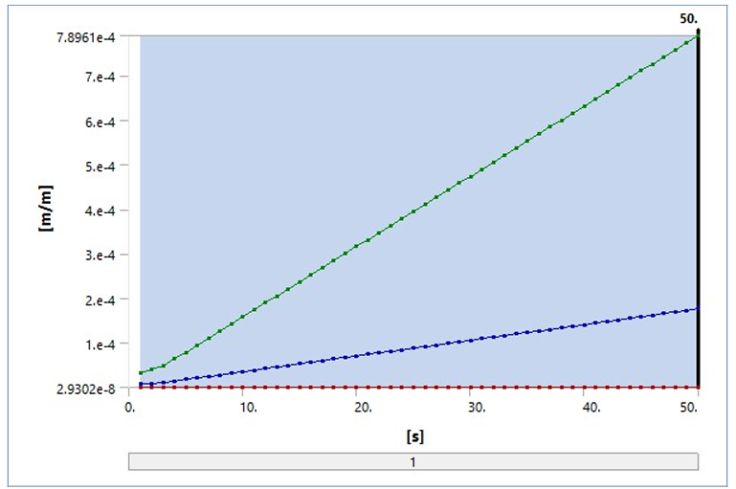
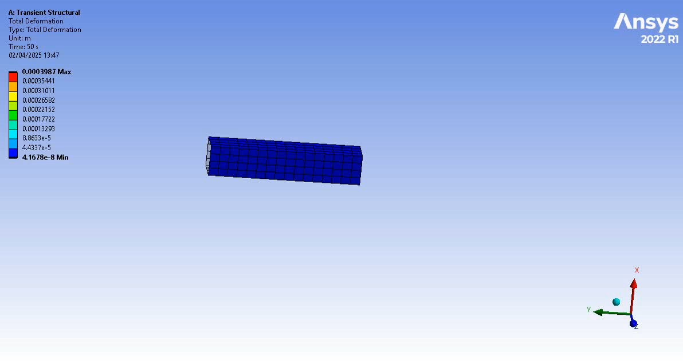
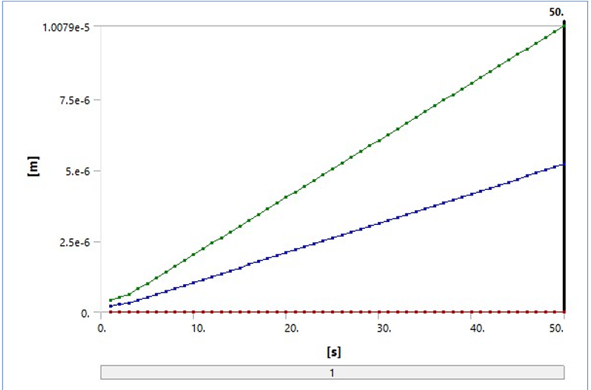
Material Selection Analysis using Ansys
Setup With Torsion Bar
Stainless Steel
1 Nm - 7.5104e-007 m
50 Nm - 1.6339e-004 m
Aluminum
1 Nm - 7.0396e-006 m
50 Nm - 1.7599e-004 m
Stainless Steel with Aluminum Alloy
1 Nm - 6.2111e-006 m
50 Nm - 1.5528e-004 m

Slide 11
Dielectric Material Evaluation
 | PTEF (Teflon) | Polyimide (Kapton) | Alumina Ceramic (Al2O3) | FR4 (Glass Epoxy) | Polycarbonate
Dielectric Constant | 7 | 9 | 10 | 8 | 6
Flexural Strength | 4 | 7 | 9 | 10 | 5
Ease of Machining | 8 | 6 | 3 | 7 | 9
Stability | 9 | 8 | 10 | 8 | 7
Cost | 6 | 4 | 3 | 9 | 10
Total | 34 | 34 | 35 | 42 | 37
According to evaluation , best dielectric material for the project appears to be FR4 (Glass Epoxy).
Dielectric Constant – Around 4.5
Can use CNC milling, laser cutting.
Industry standard PCB material, readily machined by PCB fabrication shops.

Slide 12
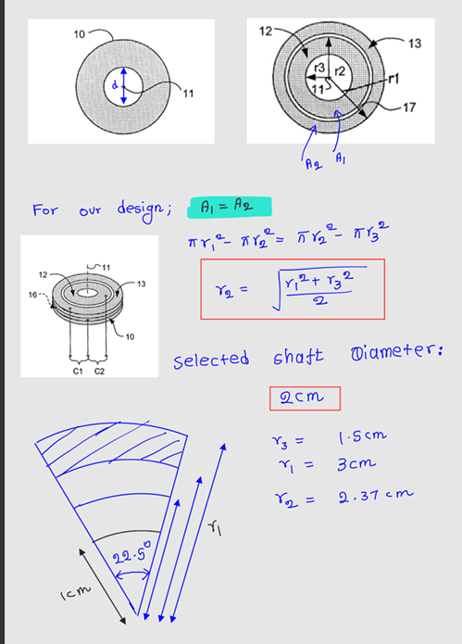
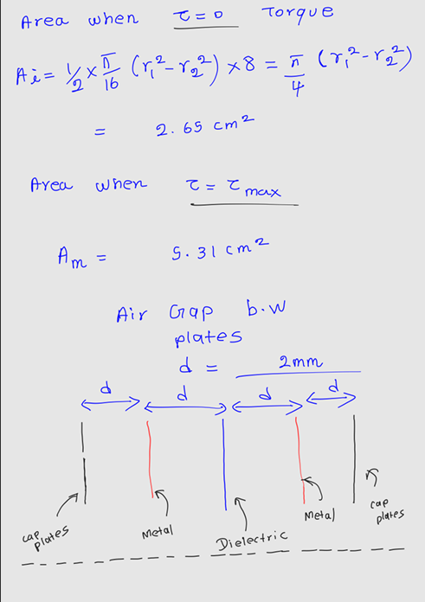
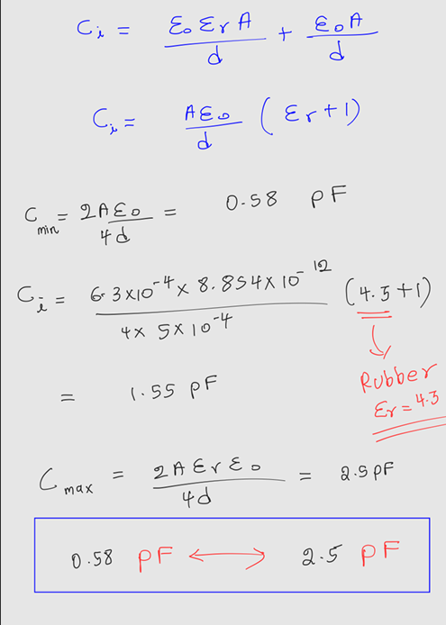
Calculations
PTEF (Teflon)
Polyimide (Kapton)
Alumina Ceramic (Al2O3)

Slide 13
Capacitive Measuring Techniques
AC Bridge Measurement– Determines an unknown capacitance by balancing an AC bridge circuit (e.g., Schering Bridge) using reference components.
Capacitance to Digital Conversion – A capacitance to digital converter directly measures capacitance and converts it into digital signal.
Phase Sensitive Detection (Lock In Amplifier)– Uses an AC signal, and a phase sensitive detector extracts phase shifts due to capacitance variations.
Charge Discharge Time Measurement – Measures the time for a capacitor to charge/discharge through a known resistor.

Slide 14
Capacitor Measurement Techniques Evaluation
 | CDC | Lock in Amplifier | Charge Discharge Time Measurement | AC Bridge
Precision | 9 | 10 | 6 | 8
Cost | 5 | 3 | 10 | 7
Complexity | 9 | 4 | 8 | 5
Robustness | 9 | 9 | 6 | 7
Total Score | 32 | 26 | 30 | 27
High Accuracy & Resolution – Provides precise digital output with minimal noise.
Direct Digital Output – Eliminates the need for complex analog processing.
High Speed – Can perform rapid capacitance measurements.
Some CDCs Include Environmental Compensation

Slide 15
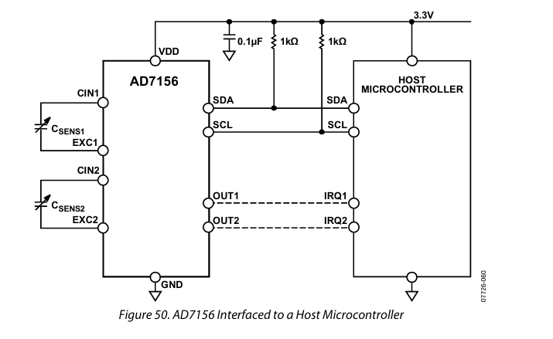
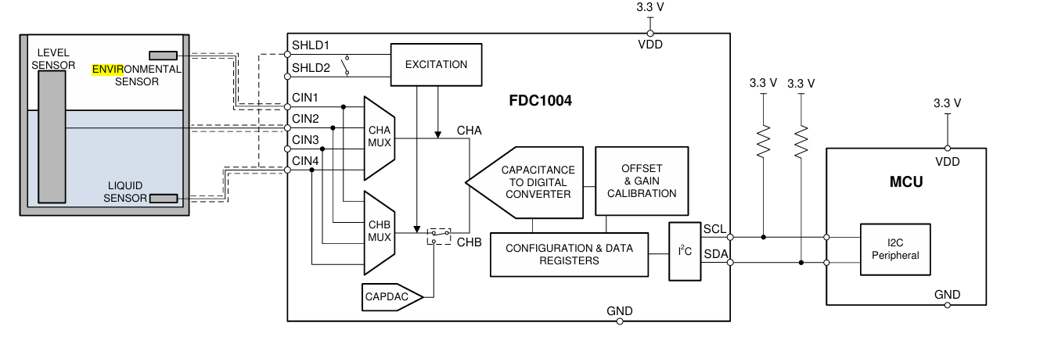
CDC Options
Analog Devices – AD7156
Sensor capacitance : 0 pF up to 13 pF
Sensitivity : up to 3 fF
Adaptive environmental compensation
Analog Devices – AD7156
Sensor capacitance : ±4pF
Sensitivity : up to 4 fF
Temperature Sensor on Chip
Texas Instruments– FDC1004
Sensor capacitance : ±15pF
Measurement resolution: 0.5fF
Programmable output rates: 100/200/400 S/s
Capacitor Plate Integration Example

